Slide 1
Developing Artificial Intelligence Applications
Ajit Jaokar
Oct 2020

Slide 2
Timings
10:00 – 11:30 and
12:30 – 14:00 and
break times
5 mins around 10:45 and 13:15
We will be online around 9:45 every day of the course

Slide 3
Introductions

Slide 4




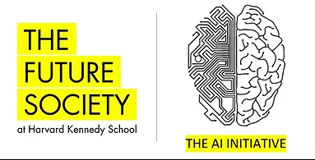
Projects
Principal Data Scientist
Bioinformatics
Cybersecurity
Robotics
Tensorflow and Keras

Slide 5




Course development team
Ayse Mutlu
Dr. Amita Kapoor
Anjali Jain
Marina Fernandez

Slide 6

Anthony Bashall
https://www.linkedin.com/in/bashall/
I was privileged to be part of the very first course in Data Science for Internet of Things at Oxford University. I run a Life Sciences & Healthcare focused AI company based at Alderley Park in Cheshire. We have seen AI in medicine and related fields evolve very rapidly even as the initial course progressed. I have also seen how rapidly this course has evolved in such a brief time to meet ever changing dynamic needs. I still stay in touch with Ajit and we continue to meet and exchange relevant information. I wish him all the best for his cutting-edge work for the future.

Slide 7

Dr Michelle Dominguiez
https://www.linkedin.com/in/michelledomr/
I was part of the Data Science for IoT course for the batch ending Feb 2019.
I am originally from Mexico and I spent the course duration here in the UK. Ajit guided me and mentored me through the class and beyond (when I returned back home). I am now working as an Engineer with John Deere in Mexico and I am using the knowledge from the course. The course and the whole team at Oxford led by Ajit were both informative and inspiring and I wish Ajit all the best in the future

Slide 8

Jakob Okpere
https://www.linkedin.com/in/jacob-okpere-8688ab1b/
I am currently a Data Engineer/ Data Scientist at Samsung. When I was a part of the Data Science for IoT course (batch completed in Feb 19) – I had just started with Data Science at Samsung. This course gave me the confidence to take on much more AI / Machine learning related work in my job and has helped me to transition into this role. Ajit has always been accessible during this course at all hours and even now, we stay in touch. The course has been a great learning and a transitional experience for me.

Slide 9

Dr Abbas Al Shimary
https://www.linkedin.com/in/abbas-al-shimary-a2641b75/
It was great to work with Ajit for the Data Science for IoT course. I met Paul Clarke (CTO of Ocado guest presenter on the course) and now I have joined Ocado. My job allows me to put into practice many of the complex and pioneering techniques I learnt in class in Oxford. Through this course, Ajit provided a deep perspective of AI – both from a technical and a strategic standpoint. He also provided many useful contacts that I am still in touch with. I wish Ajit and this course all the best for the future and look forward to staying in touch

Slide 10

Robert Wolf
Self-taught software developer Robert Wolf applied for the Artificial Intelligence: Cloud and Edge Implementations course as a way of steering his career in a new direction.
https://www.conted.ox.ac.uk/profiles/student-spotlight-robert-wolf

Slide 11
'For the past 25 years, I've had a career as a software developer and web developer using Microsoft C, C++, C# and Microsoft.NET. I’ve produced code for embedded systems, built Android and IOS apps and also managed IT systems within numerous companies. For the last 4 years though, I’ve been working as a software engineer and system developer for a company working within the UK and global power systems sector. My main focus has been on designing software to gather and process data from edge devices, whilst also processing the systems behind those devices.

Slide 12
'My company has projects where machine learning is at the core of the customer offering and after 25 years in software development – mainly in business and web systems, I felt I needed to change my career. I was interested in machine learning and the associated systems development, so the Artificial Intelligence: Cloud and Edge Implementations course seemed like a great opportunity.

Slide 13
'I do not come from an academic background. Being self-taught I found many of the higher mathematics to be a little difficult and my 1990 GCSE Maths was being pushed to the limit! However, I’d already used many of the mathematical concepts such as tahn, sigmoid, relu and other tools in both software engineering and hardware designs, so it was about having the confidence in myself to just go for it.

Slide 14
'The course is pretty fast-paced so my previous training and experience in software development and design helped. I managed to get my head around the major components of machine learning pretty quickly – fast enough to produce commercial work within half of the time taken in the course.

Slide 15
'The most rewarding moment for me was after a particularly good session in Oxford – I had a lightbulb moment while travelling home. When I got back I started to make a research project to detect events in data system by visualising the data and then using a CNN model to detect the faults. The research I did there was validated later on by others and positively re-enforced my understanding of machine learning coursework.

Slide 16
'To anyone considering undertaking this course, I say to believe in yourself. It seems quite daunting at the start as the information overload can be overwhelming. Like driving a car – you often don’t need to know how things work under the hood but you know how to use the controls. I found that a similar approach was needed for learning about artificial intelligence and machine learning – some topics at first seem impenetrable but over time the fog clears and the concepts fall into place.

Slide 17
Mindset

Slide 18
Approach
· Problem-solving approach
· Challenge to learn in a reasonably short time,
· Complex topic – emphasis on deep learning
· Goal is to apply what you have learned, pragmatic(jobs)
· Assignments, Quiz and Submission dates
· Group assignments
· Coding support – Ayse, Anjali and Marina (also Amita is online if needed)
· More time – 3 weeks after last session to send all assignments

Slide 19
· Where to post technical questions – Questions for tutors channel (this includes questions from group / private channels)
· We aim to answer questions within the week
·

Slide 20
Mindset
Immersive
Imposter syndrome and AI
Scope advanced - in my assessment you can do this
There was a waiting list! So people selected are best from that list
Discussion matters- we prioritize discussion – we can catch up on content in various ways
Repetition
Not an easy course but very applicable
Communicate – don’t go quiet!
One on Ones tech chats / career advice etc. with me are possible. You can message me through TEAMS or Canvas

Slide 21
Do not disappear!
Keep submitting – do not try to do in the last minute
You will not understand everything immediately but over the time of the course you will understand more
I may not have all the answers immediately – so we keep a list of things to ‘come back to’ and normally we should get the answer within the week

Slide 22
Class composition

Slide 23
Class composition
Please list a set of keywords that describe your technical career so far - as many as you can (e.g. Java, SQL).
•Java, J2EE, SQL, Unix, etc.
•Solution Architect
•Python
•OOP
•Pandas
•SQL
•Tableau
•C++
•Scala
•JavaScript and JS frameworks
•Some strong on Python for data science
•Hadoop and variants like spark

Slide 24
What do you wish to achieve from this course?
•Basic knowledge in developing AI apps or services using Python and TensorFlow,
•Help in proposing solutions to clients
•Understanding of machine learning and deep learning techniques
•Further experience and deep understanding in machine learning techniques
•Developing AI applications for specific industries
•Further your career
•Looking to learn about deep learning

Slide 25
•Understand how to apply algorithms
•Understand CNNs and RNNs
•Increase coding skills
•Increase my network in AI
•Learn about the tools
•Solve day to day problems
•Transition my career from academia to industry
•Gain knowledge of TensorFlow

Slide 26
Are you familiar with terms like regression, classification, etc. (either from reading or online courses) – if so, can you elaborate?
•No, I am not aware of these terms
•Yes
•Certified by AWS
•Andrew Ng course
•Previous degree had a statistical component but not familiar with Python
•MATLAB

Slide 27
Have you ever implemented algorithms like xgboost, logistic regression, etc.?
•No
•Used logistic regression in online ML tutorials
•Yes
•done as part of Andrew Ng machine learning course
•used logistic regression as statistical analysis tool in previous
•implemented advanced algorithms like genetic algorithms
•more familiar with logistic regression

Slide 28
Have you worked with Keras or TensorFlow?
•No
•Used TensorFlow 2 during Machine Learning classes
•Yes, but I am not an expert
•Yes, but only as part of coursework.

Slide 29
Are you familiar with Pandas, NumPy, or Matplotlib? If so, how (in one paragraph)?
•Somewhat
•I am familiar with these python libraries, but have not used them extensively.
•Yes, but very basic.
• I have used NumPy and Matplotlib for a reinforcement learning BlackJack project.
•No
•Very experienced

Slide 30
•use pandas, NumPy and matplotlib to analyze datasets, automate plotting and I/O communication between different applications.
•use these libraries for ETL pipelines to transform the raw data into useful information.
•I have been using python on a daily basis for my postdoctoral research.
•I am aware of MathplotLib from my Python training course, but would not say I am familiar with it.
•Yes, I use them professionally as well as for hobby/educational projects.

Slide 31
Flow of the course

Slide 32
Session outline and notes document

Slide 33
Course Objectives

Slide 34
Foundations
- Introduction to machine learning, deep learning and AI
- Introduction to neural networks, TensorFlow and Keras
- Introduction to neural networks
Introduction to Artificial Intelligence applications

Slide 35
Classification and Regression
●Understand the difference between Classification and Regression
●Delve deep into Linear and Logistic Regressors
●Understand the concept of baseline
●Understand the need and method of regularization
●Learn how to use TensorFlow Estimator API to build Classification and Regressor models.

Slide 36
Convolutional Neural Networks
●Learn how to use neural networks for image processing applications.
●Understand the concept of receptor fields
●Learn the in-depth working of convolutional neural networks.
●Build LeNet architecture in TensorFlow 2.

Slide 37
Natural Language Processing
●Understand the concept of word embeddings
●Explore the Gensim API for NLP task
●Understand to use and fine-tune Word2Vec and glove word embeddings
●Learn to build 1D CNN for the text classification task

Slide 38
Recurrent Neural Networks
●Understand the difference between recurrent and feed-forward networks.
●Delve into the working of recurrent neural network
●Understand the problem of vanishing and exploding gradients
●Go deeper into the architecture and working of LSTM and GRU

Slide 39
Autoencoders
●Learn the architecture of autoencoders
●Unravel the magic of denoising and sparse autoencoders
●Understand how images can be generated using Variational Autoencoder

Slide 40
Unsupervised Learning
●Understand the difference between supervised and unsupervised learning
●Learn about the process of clustering and its applications
●Understand the principles of dimensionality reduction
●Apply the algorithms of clustering to cluster data

Slide 41
Deep Learning on Cloud
●Explore cloud platforms offered by Microsoft, Google and Amazon
●Learn how to create your own virtual machines on the cloud
●Use TensorFlow extended for production.

Slide 42
Recorded session - no exercise TensorFlow and Cloud
Deep Learning on Cloud
Microsoft Azure, Amazon Web Services (AWS), Google Cloud Platform (GCP)
Virtual machines on Cloud
TensorFlow Extended for production
Recorded session - Working with real life applications – processes
Working with real life applications – Agile, Cloud, etc.

Slide 43
Book references and code

Slide 44
Exercise

Slide 45
https://canvas.ox.ac.uk/courses/67697/assignments/187280
Coding exercise: Python libraries. Regression and Classification
Pandas
Numpy
Matplotlib
SkLearn
Regression
Classification

Slide 46
Basic concepts

Slide 47
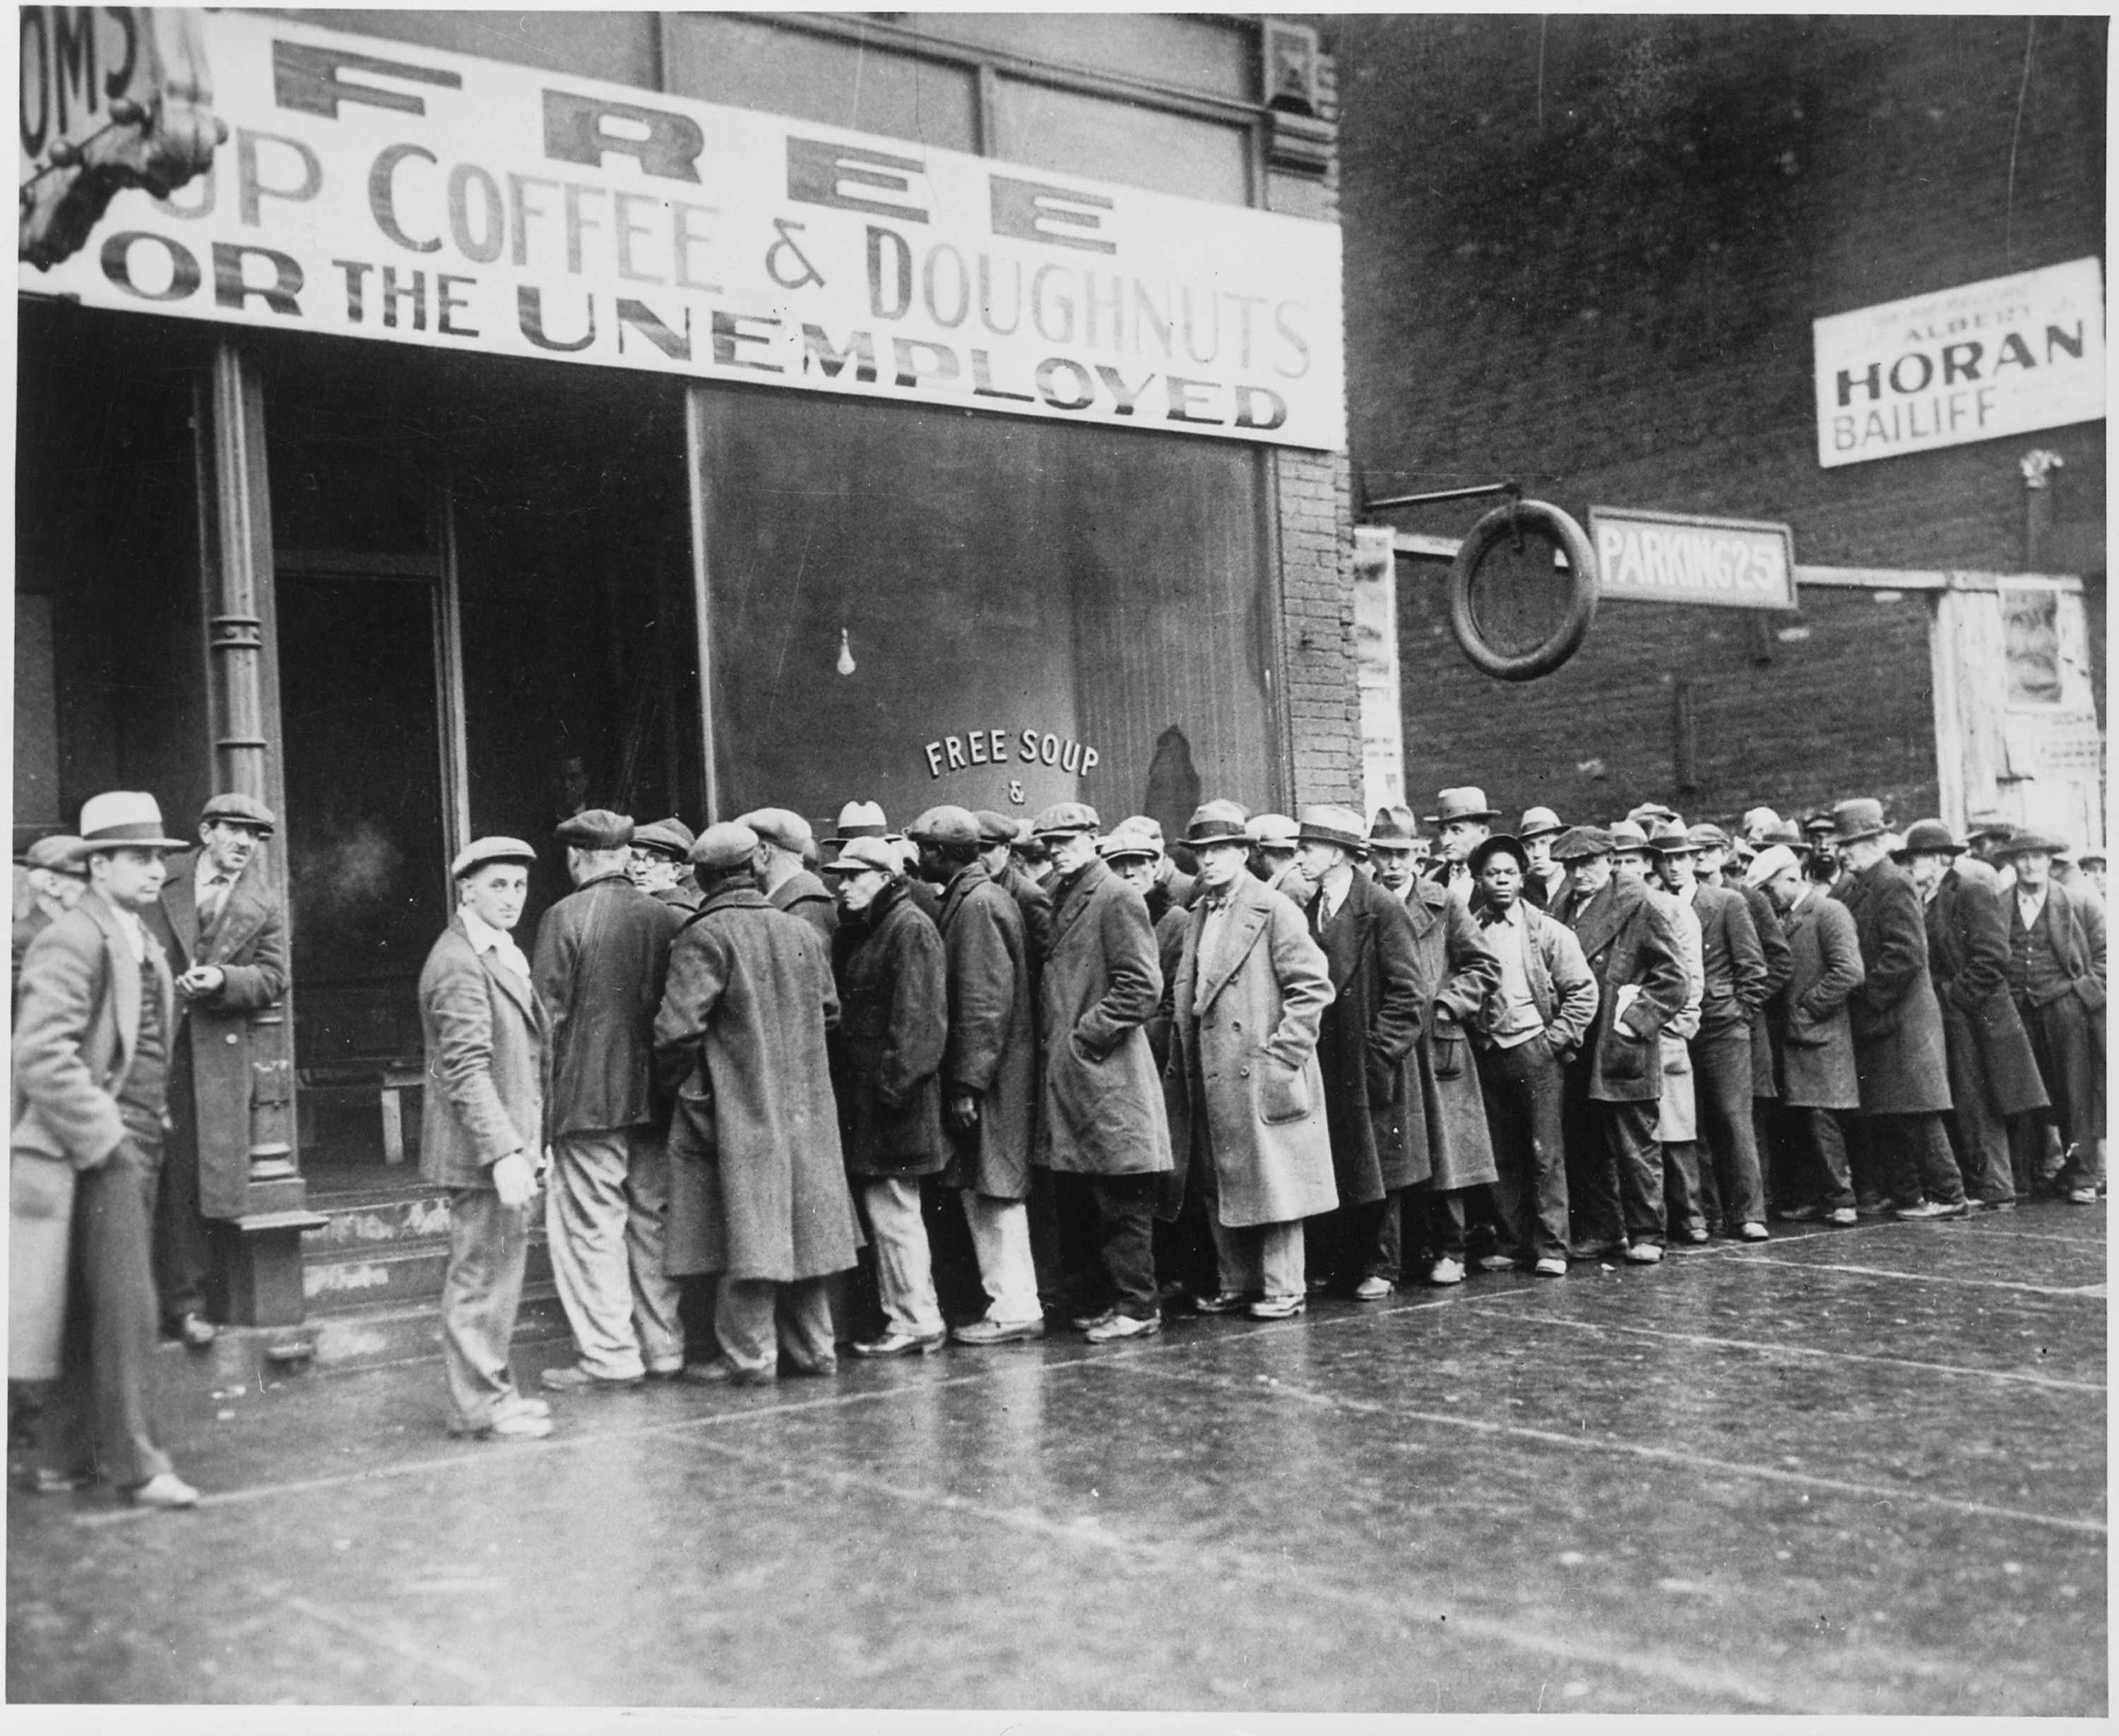
Image source: Wikipedia

Slide 48

Image source: wikipedia

Slide 49
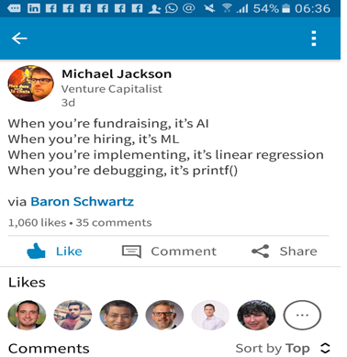

Slide 50

Image source: https://towardsdatascience.com/no-machine-learning-is-not-just-glorified-statistics-26d3952234e3

Slide 51

Image source: Wikipedia

Slide 52
Machine learning vs Deep Learning vs AI
Broadly …
Machine Learning = Explicitly training an algorithm
Deep Learning = Automatic feature detection(representation learning)
AI = Machines that can think and Reason (based on mainly Deep Learning algorithms)

Slide 53
When to use machine learning/deep learning?
The problem is very large
The problem is open ended
The problem changes
The problem is hard
The problem has ‘hidden rules’
The problem has hierarchical rules
The problem has many variants around a core
The problem is generative
Adapted from Thinking like a Machine Learning Architect
http://blog.intelligentsystem.io/2020/04/thinking-like-a-machine-learning-architect/

Slide 54
Traditional
Programming
data
outcomes
rules
data
Machine
Learning
rules
Outcomes

Slide 55
Working Problems Like a Data Scientist
OSEMN Process (Hilary Mason and Chris Wiggins)
Obtain Data : ex JSON and scripting languages
Scrub Data
Explore Data: “Explore” refers to exploratory data analysis (aka: no hypothesis that is being tested and no predictions that are being evaluated).
Command Line Tools
Histograms
Dimensionality Reduction Methods
Clustering to expose natural groupings in the data

Slide 56
Model Data (machine learning stage): Here, we apply the predictive models (regression, classification etc.). A model’s predictive accuracy can be evaluated by how well it performs on unseen data.
Interpret Results: In contrast to prediction which can be evaluated quantitatively, whereas interpretation is softer and qualitative and often visual.

Slide 57
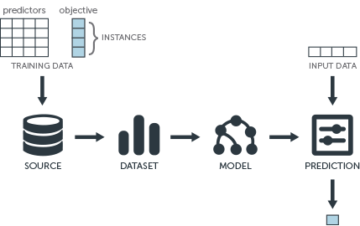
Image source: https://www.bbvaapimarket.com/en/api-world/apis-and-machine-learning-how-predict-companys-success/

Slide 58
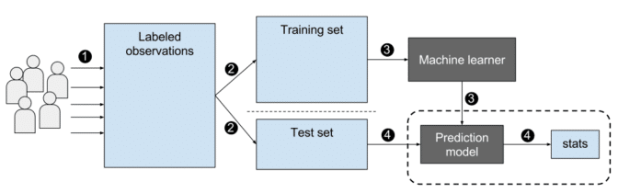
A more detailed overview of the general process:
Image source: https://blogs.nvidia.com/blog/2018/08/02/supervised-unsupervised-learning/

Slide 59
Statistical techniques
linear algebra basic statistics linear and logistic regression data mining predictive modelling cluster analysis association rules | market basket analysis decision trees time-series analysis forecasting machine learning Bayesian and Monte Carlo Statistics matrix operations sampling | text analytics summarization classification primary components analysis experimental design unsupervised learning constrained optimization

Slide 60
Computer science
Columnar databases Analytic accelerators Hadoop/ MapReduce NoSQL engines Stream computing In-memory analysis | Workload optimization Scripting and development tools Complex event processing Information integration Scalable storage infrastructure High-capacity warehouse | Visualization – Data Discovery Cloud infrastructure for Analytics Amazon Elastic Map Reduce Google BigTable

Slide 61
Data formats
Image
Video
Text
Time series
Audio

Slide 62
Modalities
Cloud
Edge
DevOps / MLOps/ CI-CD

Slide 63
Machine learning

Slide 64
Machine learning vs Deep Learning vs AI
Broadly …
Machine Learning = Explicitly training an algorithm
Deep Learning = Automatic feature detection (representation learning)
AI = Machines that can think and Reason (based on mainly Deep Learning algorithms)

Slide 65
What is Machine Learning?
Mitchell’s Machine Learning
“The field of machine learning is concerned with the question of how to construct computer programs that automatically improve with experience.”
v
Formally
“A computer program is said to learn from experience (E) with respect to some class of tasks (T), and performance measure (P), if its performance at tasks in T, as measured by P, improves with experience (E).”

Slide 66
From a Programmers Perspective
Think of it as a design tool used to understand:
What data we collect for the experience (E), what decisions the software needs to make (T), and how we evaluate the results (P).
Machine Learning involves:
Training of a model from data
Predicts/Extrapolate a decision
Against a performance measure.

Slide 67
Types of Problems
Classification: Data is labelled, (assigned a class); for example spam/non­spam or fraud/non­fraud. Decision – assign labels to a new type of data
Regression: Data is labelled with a real value rather than a label. Decision -relationship between inputs and outputs.
Clustering: Data is not labelled, but can be divided into groups based on similarity and other measures of natural structure in the data. Decision – organizing into groups
Rule Extraction: Decision - extraction of propositional rules (antecedent/consequent or if then).

Slide 68
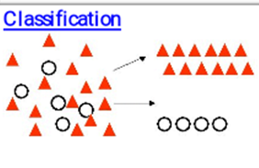
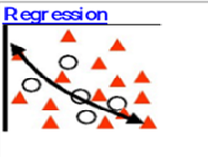
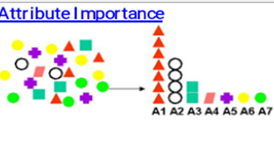
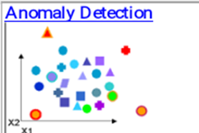
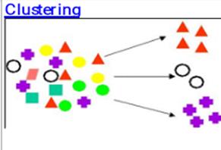
Image source: adapted from Oracle

Slide 69
Algorithms and Problem solving

Slide 70
Categorization of Algorithms
By learning style.
By similarity in form or function

Slide 71
Algorithms Grouped by Learning Style
1. Supervised Learning
Supervised Learning Algorithms - Input data has a label.
A model is prepared through a training process which continues till a desired level of accuracy is obtained on the training data. Examples: classification and regression. Example algorithm: Logistic Regression

Slide 72
2. Unsupervised Learning
Unsupervised Learning Algorithms: Input data is not labeled. Model building involves understanding the underlying structure for the data. Examples: clustering, dimensionality reduction and association rule learning. Example algorithms: K-Means.

Slide 73
Anomaly detection: Ex - Banks detect fraudulent transactions by looking for outlier patterns. Unsupervised learning is used in fraud detection because the malicious cases are very few and it’s not possible to train an algorithm on them (ex very few fraud cases vs non-fraud cases)

Slide 74
3. Semi-Supervised Learning
Semi-supervised Learning Algorithms: Input data is a mixture of labeled and unlabeled examples. Ex generative models.

Slide 75
Algorithms Grouped By Similarity
Algorithms are often grouped by similarity in terms of their function (how they work). For example, tree-based methods, and neural network inspired methods.

Slide 76
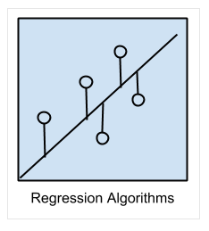
Regression Algorithms
Regression Algorithms: modelling a relationship between variables. Examples: Ordinary Least Squares Regression (OLSR), Linear Regression
Image source: Jason brownlee

Slide 77
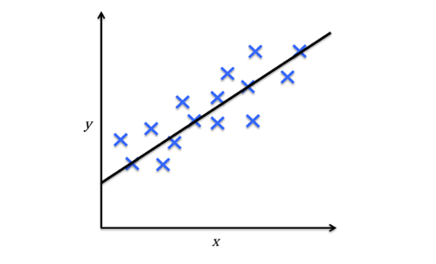
Regression
Image source: https://towardsdatascience.com/machine-learning-introduction-a-comprehensive-guide-af6712cf68a3

Slide 78
Classification Algorithms
Ex SVM, Logistic regression etc.
Image source: Jason brownlee

Slide 79
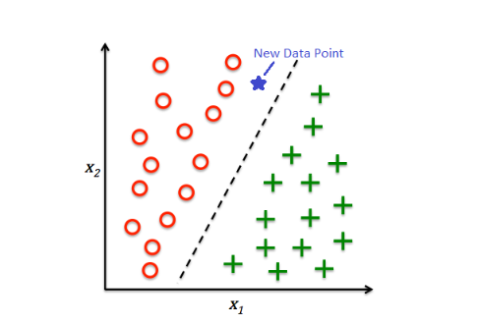
Image source: https://towardsdatascience.com/machine-learning-introduction-a-comprehensive-guide-af6712cf68a3

Slide 80
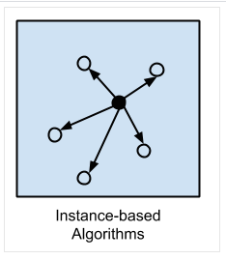
Instance-based Algorithms
Creates a similarity measure from example data and then compare a new instance to the measure based on the similarity measure. The most popular instance-based algorithms are: k-Nearest Neighbor (kNN)
Image source: Jason brownlee

Slide 81
Regularization Algorithms
Regularization Algorithms: Typically extend regression methods) that penalizes models based on their complexity, favoring simpler models that are also better at generalizing.

Slide 82
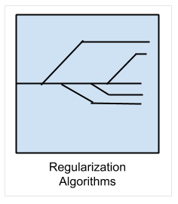
The most popular regularization algorithms are:
Ridge Regression
Least Absolute Shrinkage and Selection Operator (LASSO)
Elastic Net
Least-Angle Regression (LARS)
Image source: Jason brownlee

Slide 83
Decision Tree Algorithms
Decisions fork in tree structures until a prediction decision is made for a given record. Decision trees are often fast and accurate

Slide 84
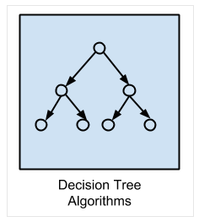
The most popular decision tree algorithms are:
Classification and Regression Tree (CART)
Image source: Jason brownlee

Slide 85
Bayesian Algorithms
Bayesian Algorithms: Apply Bayes’ Theorem for problems such as classification and regression.

Slide 86
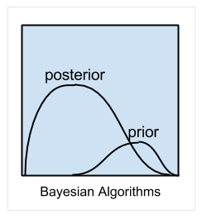
An example of Bayesian algorithm
Naive Bayes
Image source: Jason brownlee

Slide 87
Clustering Algorithms
Clustering Algorithms are concerned with using the inherent structures in the data to best organize the data into groups of maximum commonality.

Slide 88
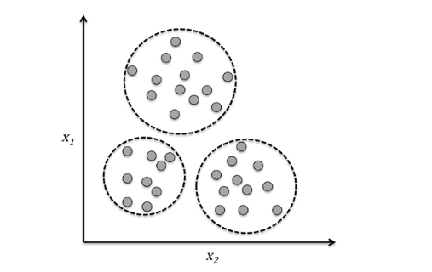
Clustering:
Image source: https://towardsdatascience.com/machine-learning-introduction-a-comprehensive-guide-af6712cf68a3

Slide 89
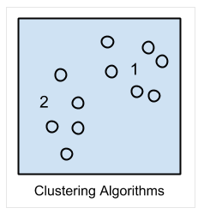
Example of Clustering algorithms:
k-Means
Image source: Jason brownlee

Slide 90
Association Rule Learning Algorithms
Association Rule Learning methods extract rules that best explain observed relationships between variables in data. These rules can discover important and commercially useful associations in large multidimensional datasets that can be exploited by an organization.

Slide 91
Association rules: {onions,potatoes} - {burger} – market basket analysis
- Web usage mining, intrusion detection, continuous
production, and bioinformatics. In contrast with

Slide 92
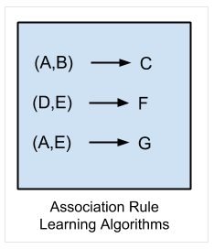
The most popular association rule learning algorithms are:
Apriori algorithm
Eclat algorithm
Image source: Jason brownlee

Slide 93
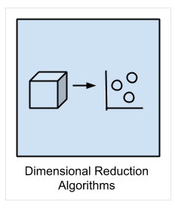
Dimensionality Reduction Algorithms
Dimensional Reduction Algorithms - exploit the inherent structure in the data to summarize or describe the data using less information. This can then be used to in supervised learning method.
Image source: Jason brownlee

Slide 94
Dimensionality Reduction:
Typically, each observation comes with a high number of features (high dimensionality). This can be a challenge because of sparse matrices and computational performance. Hence, we need dimensionality reduction.
Dimensionality reduction finds correlations between features, which could represent redundant information because some features could be partially explained with the other features.

Slide 95
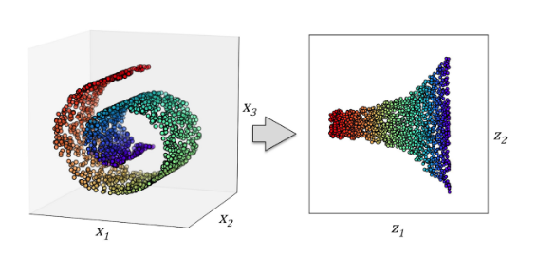
Image source: https://towardsdatascience.com/machine-learning-introduction-a-comprehensive-guide-af6712cf68a3

Slide 96
Ensemble Algorithms
Ensemble methods are models composed of multiple weaker models that are independently trained and whose predictions are combined in some way to make the overall prediction.

Slide 97
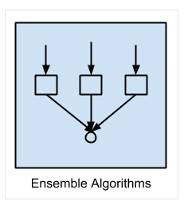
This is a very powerful class of techniques and as such is very popular.
Boosting
Bootstrapped Aggregation (Bagging)
Image source: Jason brownlee

Slide 98
Basic terminology and notations to get started

Slide 99
Basic Terminology and Notations
Each separate row of the matrix is a sample, observation or data point.
Each column is feature (or attribute) of that observation.
Usually there is one column (or feature), that we will call the target, label or response, and its the value or class that we’re trying to predict.

Slide 100
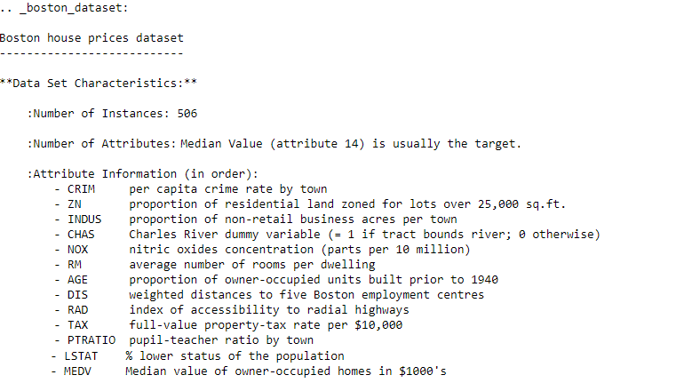

Slide 101
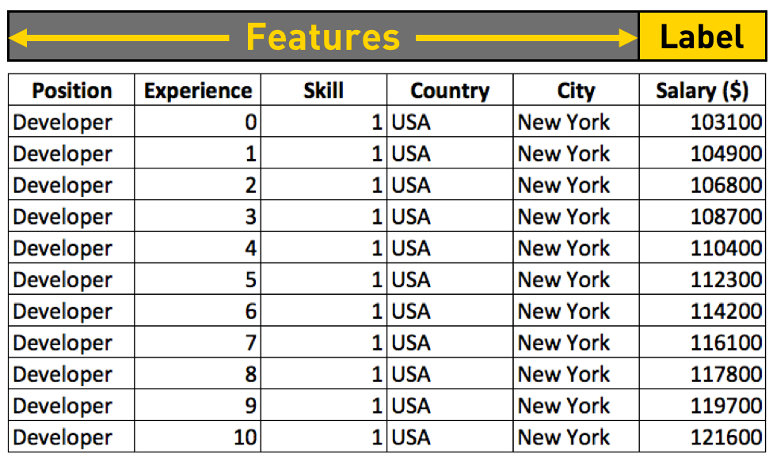
Image source: https://towardsdatascience.com/machine-learning-introduction-a-comprehensive-guide-af6712cf68a3

Slide 102
To train a machine learning model is to provide a machine learning algorithm with training data to learn from it.
machine learning algorithms usually have some other parameters. i.e.: In Decision Trees, there are parameters like depth, number of nodes, number of leaves… These are called hyperparameters.
Generalization is the ability of the model to make predictions on new data.

Slide 103
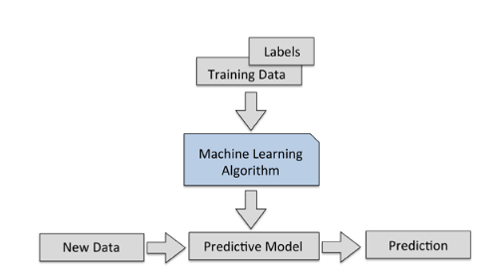
An overview of the general process:
Image source: https://towardsdatascience.com/machine-learning-introduction-a-comprehensive-guide-af6712cf68a3

Slide 104
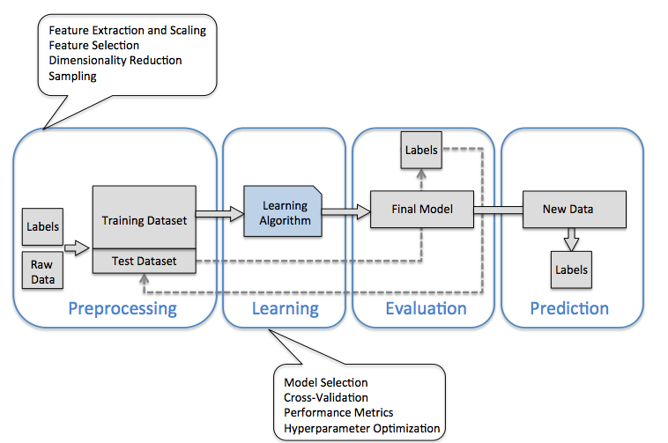
A more detailed overview of the general process:
Image source: https://towardsdatascience.com/machine-learning-introduction-a-comprehensive-guide-af6712cf68a3

Slide 105
Deep Learning algorithms

Slide 106
Artificial Neural Network Algorithms
Artificial Neural Network Algorithms: inspired by the structure and/or function of biological neural networks. Are also the basis of Deep Learning networks

Slide 107
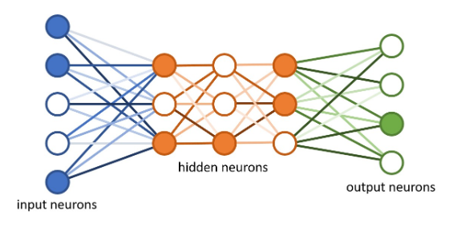
Deep Learning
Image source: https://towardsdatascience.com/machine-learning-introduction-a-comprehensive-guide-af6712cf68a3

Slide 108
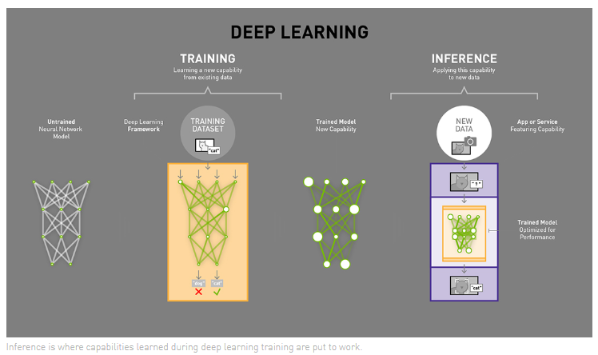
Image source https://blogs.nvidia.com/blog/2016/08/22/difference-deep-learning-training-inference-ai/

Slide 109
Autoencoders:
Autoencoders take input data
compress it then
try to recreate the input data from that compressed version
Ex: For a large novel like War and Peace –
Read the book
Create a summary
Then recreate the book based on summary
If the representation is smaller but still faithful to the original
you get a compressed version of the data.
You can also remove noise from the data.

Slide 110
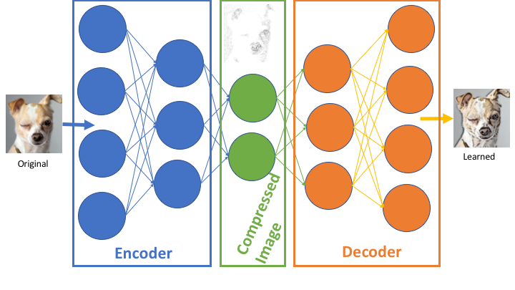
https://blog.goodaudience.com/using-tensorflow-autoencoders-with-music-f871a76122ba

Slide 111
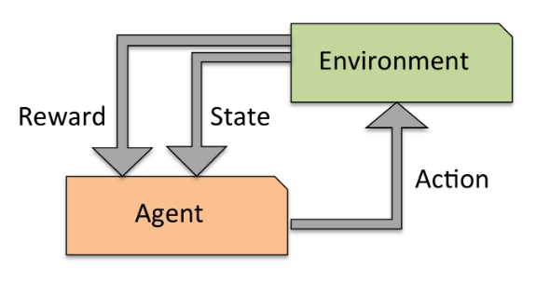
Reinforcement Learning
Learning by trial and error
Image source: https://towardsdatascience.com/machine-learning-introduction-a-comprehensive-guide-af6712cf68a3

Slide 112
What Is Reinforcement Learning?
The AI agent is attempting to find the optimal way to accomplish a particular goal or improve performance on a specific task.
The agent takes action that goes toward the goal
it receives a reward.
The overall aim: predict the best next step to take to earn the biggest final reward.
This technique is especially useful for training robots, which make a series of decisions in tasks like steering an autonomous vehicle or managing inventory in a warehouse

Slide 113
Generative Adversarial Networks(GANs)
GANs are gaining in popularity recently. GANs belong to a set of algorithms called generative models. Typically, GANs are used in cases where we generate realistic data from a given sample – typically image data.

Slide 114

Image source https://medium.com/ml-everything/generating-letters-using-generative-adversarial-networks-gans-161b0be3c229

Slide 115
Generative Adversarial Networks are composed of two models: The Generator and the Discriminator. The analogy of a forger and an art expert is often used to illustrate how GANs work. The Generator acts like a human art forger which creates fake works of art. The discriminator serves as the art expert who tries to detect these counterfeit works. If the input data belongs to the original dataset it is deemed as ‘real' or else, it is generated (and hence fake)

Slide 116
GANs (Generative adversarial networks) are an example of semi supervised learning. Art forger and art expert
Consider two deep learning networks in competition – one generates data by mimicking the training data – the other detects if the data is fake or really part of the training data. Both networks improve in a positive feedback loop
The discriminator gets better at separating the fakes from the originals
The generator improves its ability to create convincing fakes.

Slide 117
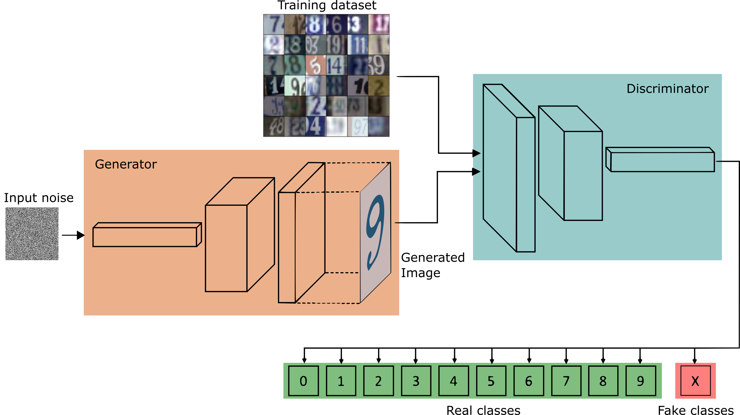
After training, we discard the discriminator because we need the discriminator only for training the generator.
Source: https://towardsdatascience.com/semi-supervised-learning-with-gans-9f3cb128c5e

Slide 118
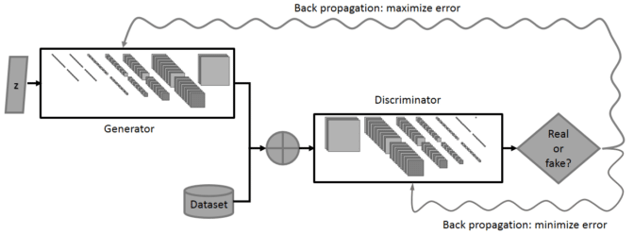
A more detailed overview of the general process:
https://blogs.nvidia.com/blog/2018/08/02/supervised-unsupervised-learning/

Slide 119
Deep Learning

Slide 120
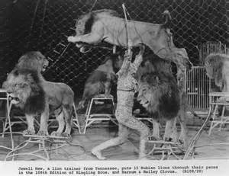
What is the best way to train ‘Big Data’ algorithms?
Training machines is a ‘hard’ problem as I will explain ..

Slide 121
How to train a Big Data algorithm?
Start with the Rules and apply them to Data OR Start with the data and find the rules from the Data
The Top-down approach involved writing enough rules for all possible circumstances. But this approach is obviously limited by the number of rules and by its finite rules base.
Bottom up approach: where there are no rules :
No models(schema),
Linearity(sequence) and hierarchy is not known
Non deterministic – output is not known
Problem domain is not finite
In contrast – transactional computing is straight forward

Slide 122
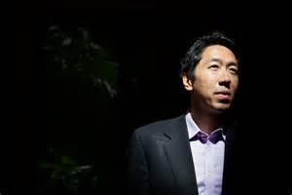
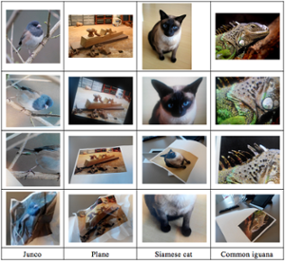
10 million images from YouTube videos – recognise pictures of Cats - without telling what a cat is
Apply them to real problems such as image recognition, search, and natural-language understanding,

Slide 123
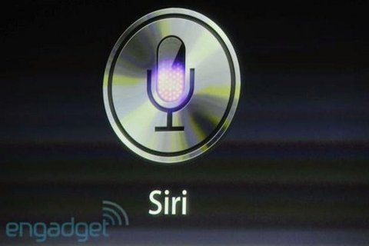
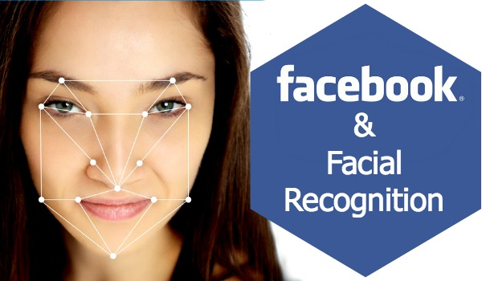

Slide 124
Big Data – training big Data
Siri and Facebook face recogniton
The idea here is to learn from experience. The experience was provided by ‘labelled data’. (Spam/No spam)
However, most data (pictures, video feeds, sounds, etc.) is not labelled and if it is, it’s not labelled well. the problem domain is not finite(there are infinite options)
Deep learning systems are possible to implement now because of three reasons: High CPU power, Better Algorithms and the availability of more data. Over the next few years, these factors will lead to more applications of Deep learning systems
They address problems that humans an find solutions to quickly – ex what is a cat .. Vs what is a dog .. But Computers cannot

Slide 125
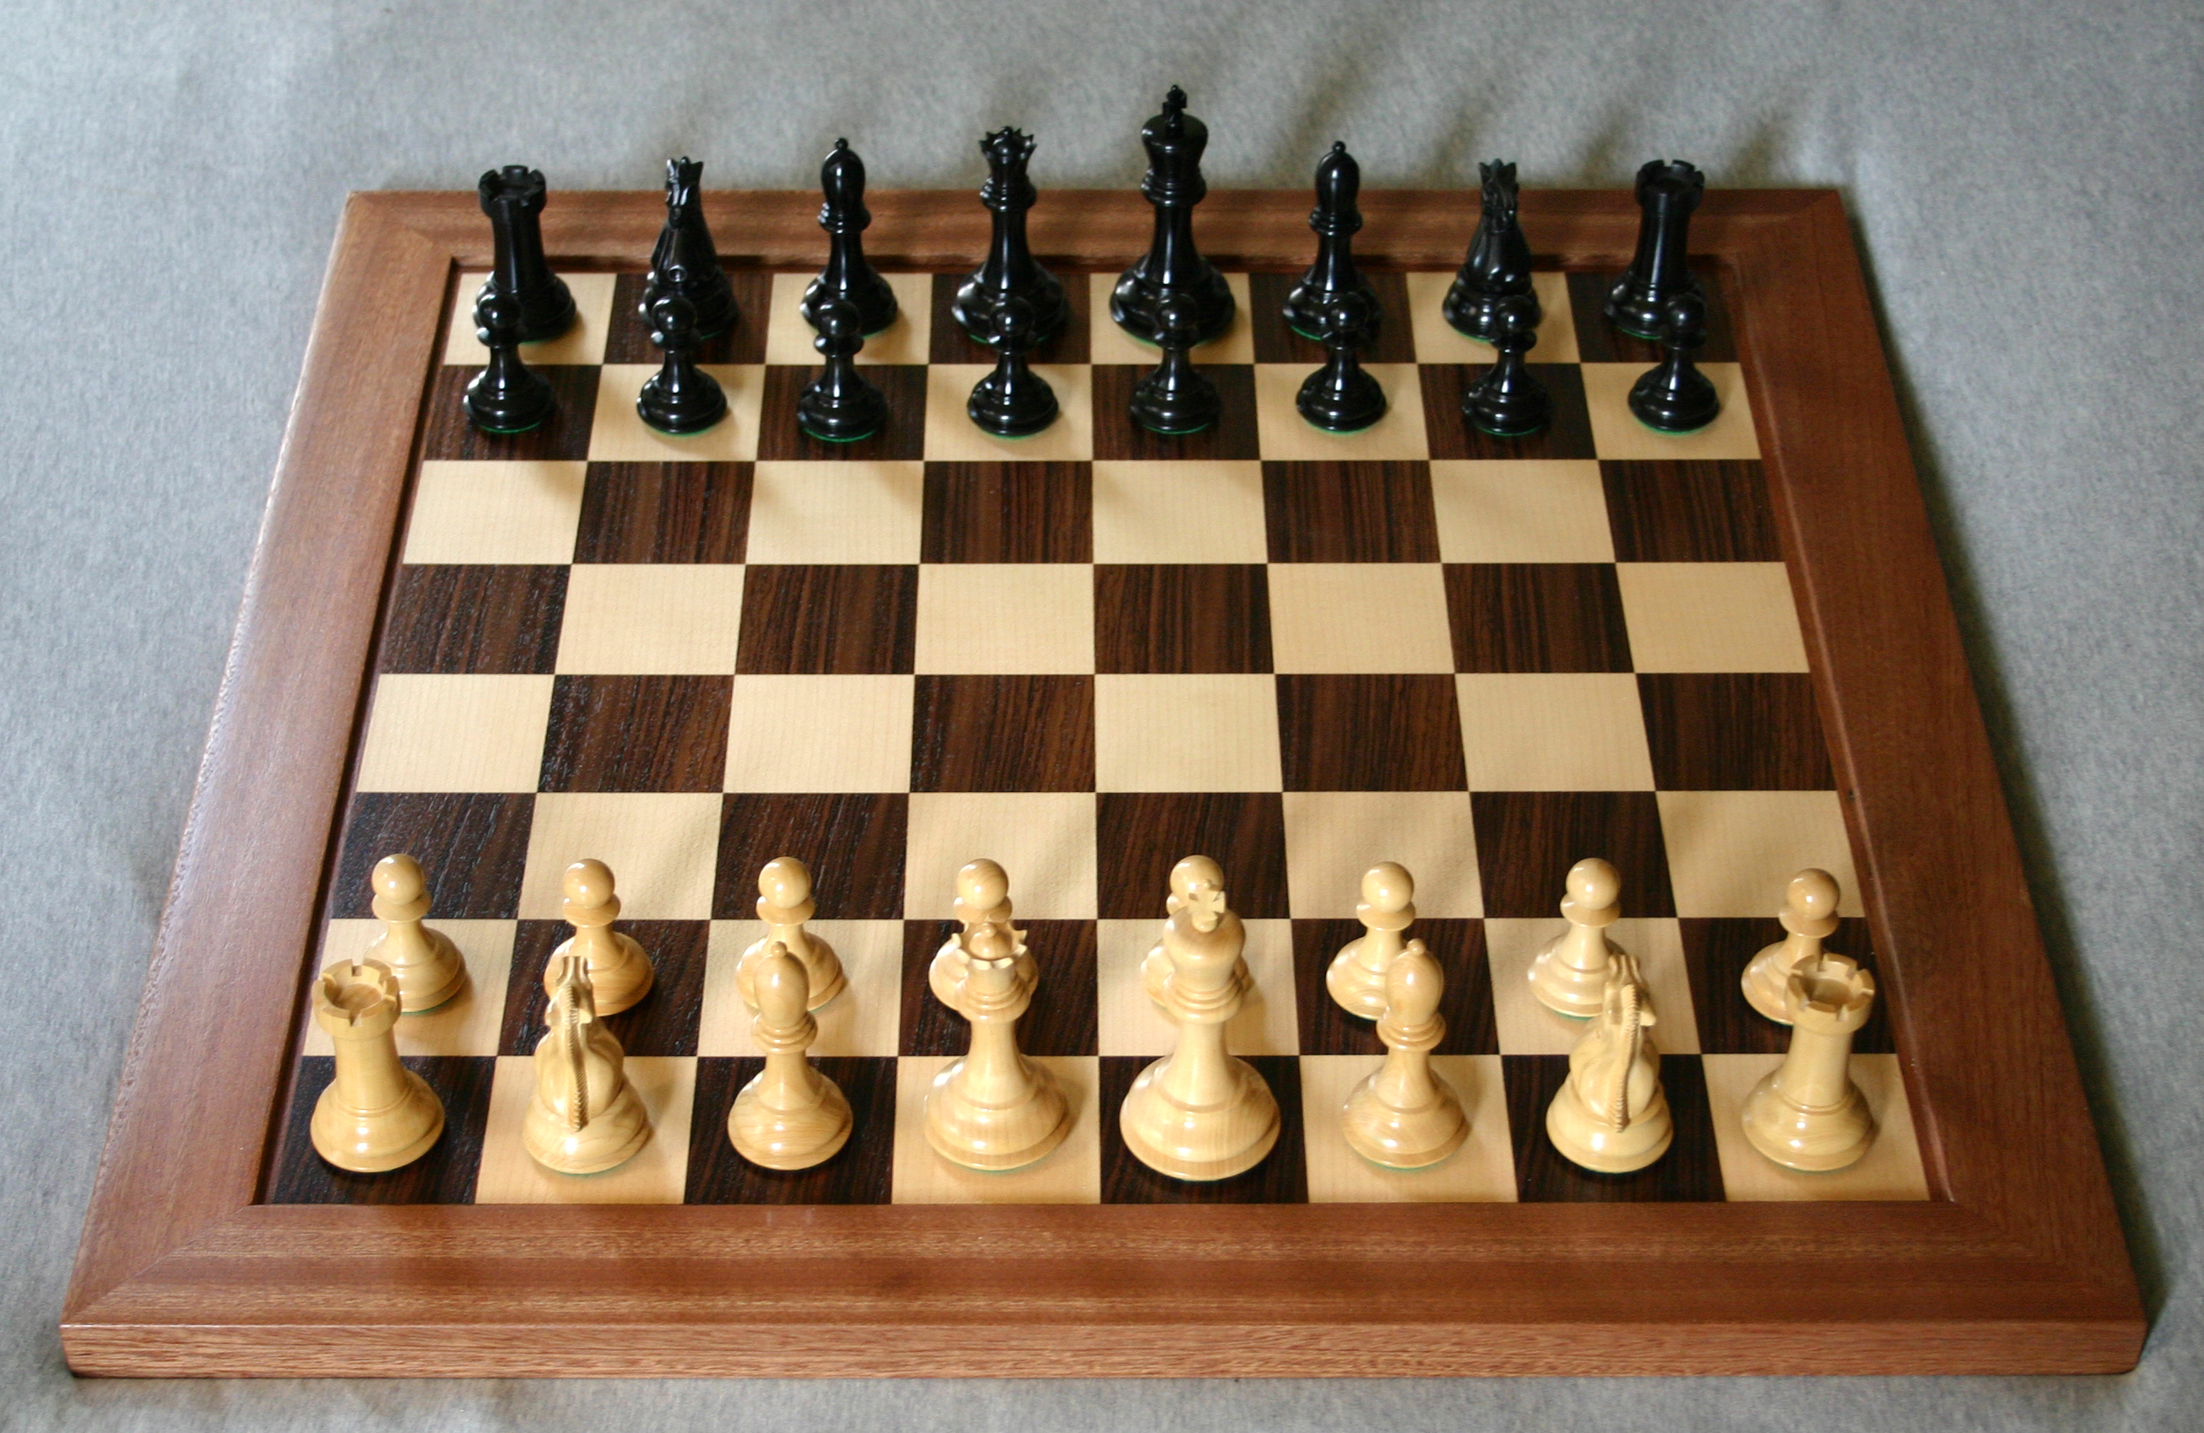

10 million images from YouTube videos – recognise pictures of Cats - without telling what a cat is
Apply them to real problems” such as image recognition, search, and natural-language understanding,
Image source: https://www.nbcnews.com/health/kids-health/here-s-reason-get-puppy-kids-pets-have-less-anxiety-n469591 and chess (Wikipedia)

Slide 126
Chess vs. Cat: Second is very hard (for a Compuer) but is easy for a Child!
How does Deep Learning help to solve the intuitive problem
The whole objective of Deep Learning is to solve ‘intuitive’ problems i.e. problems characterized by High dimensionality and no rules.
Deep learning allows computers to solve intuitive problems because:
With Deep learning, Computers can learn from experience but also can understand the world in terms of a hierarchy of concepts – where each concept is defined in terms of simpler concepts.
The hierarchy of concepts is built ‘bottom up’ without predefined rules
This is similar to the way a child learns ‘what a dog is’ i.e. by understanding the sub-components of a concept ex the behavior(barking), shape of the head, the tail, the fur etc and then putting these concepts in one bigger idea i.e. the Dog itself.

Slide 127
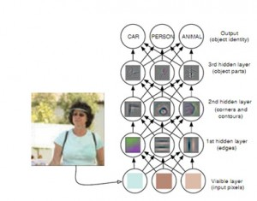
Image and example source: Yoshua Bengio book – Deep Learning

Slide 128
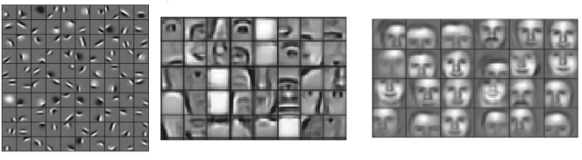
A more detailed overview of the general process:
Image source: https://towardsdatascience.com/machine-learning-introduction-a-comprehensive-guide-af6712cf68a3

Slide 129
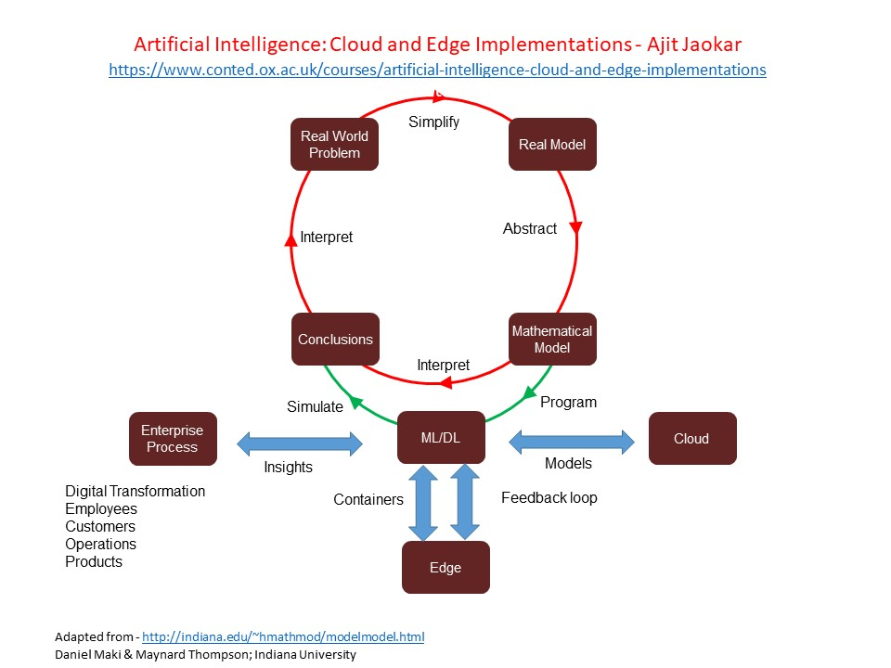

Slide 130
For example: From the pixels, the first hidden layer identifies the edges
From the edges, the second hidden layer identifies the corners and contours
From the corners and contours, the third hidden layer identifies the parts of objects
Finally, from the parts of objects, the fourth hidden layer identifies whole objects
Image and example source: Yoshua Bengio book – Deep Learning
Computers can be trained to recognize an object by showing labelled images of the object.
When a computer sees many images of the same object, it discerns a model of an object
When trained, the next time it sees an image of the object, it can identify the object

Slide 131
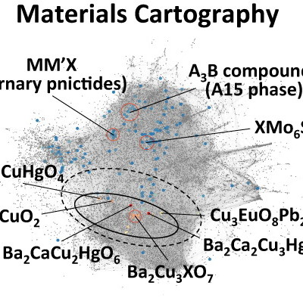
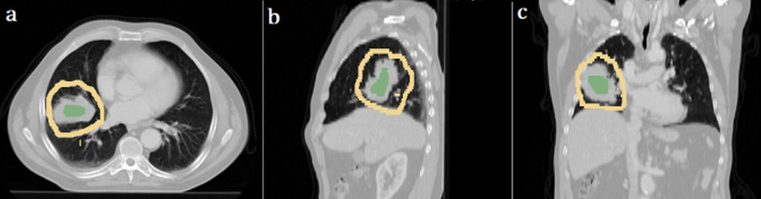
Where are these techniques being used
Detect malignant tumours
Pick out potentially useful drug molecules from hundreds of millions of candidates.

Slide 132
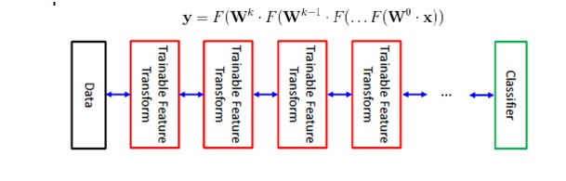
Once trained (features are selected), the input vectors are transformed into a better representation and these are in turn passed on to a real classifier such as SVM or Logistic regression. This can be represented as below.
Source: ELEG 5040 Advanced Topics on Signal Processing (Introduction to Deep Learning) by Xiaogang Wang

Slide 133
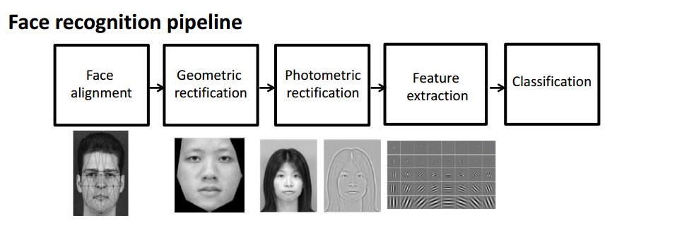
Deep Learning and Feature learning
Deep Learning can be hence seen as a more complete, hierarchical and a ‘bottom up’ way for feature extraction and without human intervention.
Source: ELEG 5040 Advanced Topics on Signal Processing (Introduction to Deep Learning) by Xiaogang Wang

Slide 134
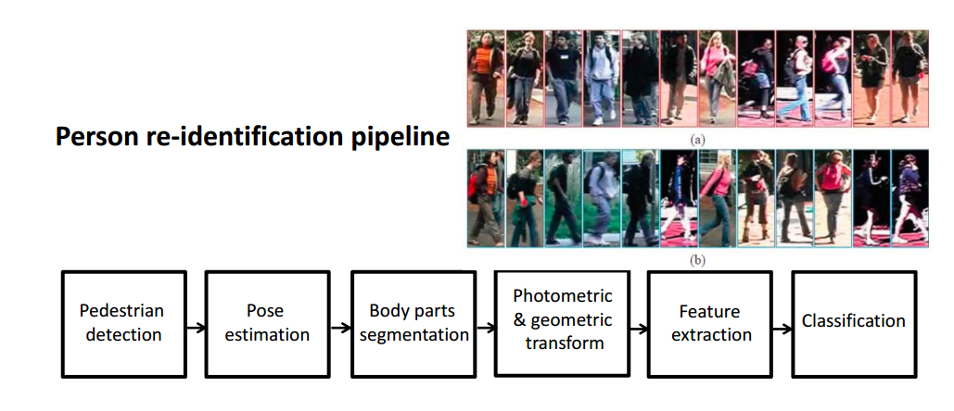

Slide 135
Gesture Recognition
The ability to analyse human actions and extract real-time information from video streams. Applies to Robots, Fall Detection, In-car monitoring, Security
Voice Biometrics or Authentication
The ability to use voice as an authentication method and identify individual speakers with speech recognition. alternatively, use voice as the authentication method.

Slide 136
Machine vision
Used in robotics, face recognition, content moderation etc.
Video surveillance
Use of AI in images from surveillance camera - often on the Edge, i.e. at the device itself. as digital brains to match their eyes.
Handwriting Recognition
Recognise and extract handwritten text

Slide 137
Text recognition and generation
Generating text - i.e. transforming data into a written narrative
Entity Recognition
Detect objects in images
Natural Language Processing
Text analysis and the ability to extract information about people, places, events from text documents. Also includes sentiment analysis, context classification and language translation

Slide 138
Movement Prediction
Prediction of movement based on images
Creating images from text
The ability to create images from text
Attention, Sentiment Tracking
tracking of emotional response based on facial movement and other techniques.

Slide 139
Types of AI problems
We now discuss the types of AI problems
1) Domain expert: Problems which involve Reasoning based on a complex body of knowledge
This includes tasks which are based on learning a body of knowledge like Legal, financial etc. and then formulating a process where the machine can simulate an expert in the field
2) Domain extension: Problems which involve extending a complex body of Knowledge
Here, the machine learns a complex body of knowledge like information about existing medication etc. and then can suggest new insights into the domain itself – for example, new drugs to cure diseases.

Slide 140
3) Complex Planner: Tasks which involve Planning
Many logistics and scheduling tasks can be done by current (non-AI) algorithms. However, increasingly, as the optimisation becomes complex AI could help. One example is the use of AI techniques in IoT for Sparse datasets AI techniques help on this case because we have large and complex datasets where human beings cannot detect patterns, but a machine can do so easily.
4) Better communicator: Tasks which involve improving existing communication
AI and Deep Learning benefit many communication modes such as automatic translation, intelligent agents etc

Slide 141
5) New Perception: Tasks which involve Perception
AI and Deep Learning enable newer forms of Perception which allow new services such as autonomous vehicles
6) Digital transformation
While autonomous vehicles etc. get a lot of media attention, AI will be deployed in almost all sectors of the economy. In each case, the same principles apply, i.e. AI will be used to create new insights from automatic feature detection via Deep Learning - which in turn help to optimise, improve or change a business process (over and above what can be done with traditional machine learning).

Slide 142
7) Enterprise AI adding unstructured data and Cognitive capabilities to the Enterprise
Majority of the data available to most organisations is unstructured – call logs, emails, transcripts, video and audio data etc. AI can be used to gain insights from this information using techniques like CNNs
8) Problems which impact domains due to second order consequences of AI
‘Second-order consequences' cover the broader impact of changing a specific process through AI. For example, introducing AI in healthcare impacts insurance

Slide 143
9) Problems in the near future that could benefit from improved algorithms
A catch-all category for things which were not possible in the past could be possible in the near future due to better algorithms or better hardware. For example, in Speech recognition, improvements continue to be made and currently, the abilities of the machine equal that of a human.
10) Super Long sequence pattern recognition
The application of AI techniques to sequential pattern recognition ex genomics.

Slide 144
Exercise for this week

Slide 145
References:
A Tour of Machine Learning Algorithms by Jason Brownlee
Machine Learning Introduction: A Comprehensive Guide Victor Roman
What’s the Difference Between Deep Learning Training and Inference? by MICHAEL COPELAND
SuperVize Me: What’s the Difference Between Supervised, Unsupervised, Semi-Supervised and Reinforcement Learning? by ISHA SALIAN
https://machinelearningmastery.com/a-tour-of-machine-learning-algorithms/
https://towardsdatascience.com/machine-learning-introduction-a-comprehensive-guide-af6712cf68a3
https://blogs.nvidia.com/blog/2018/08/02/supervised-unsupervised-learning/

Slide 146
